Slide 1
Derbyshire TB
May 2020

Slide 2
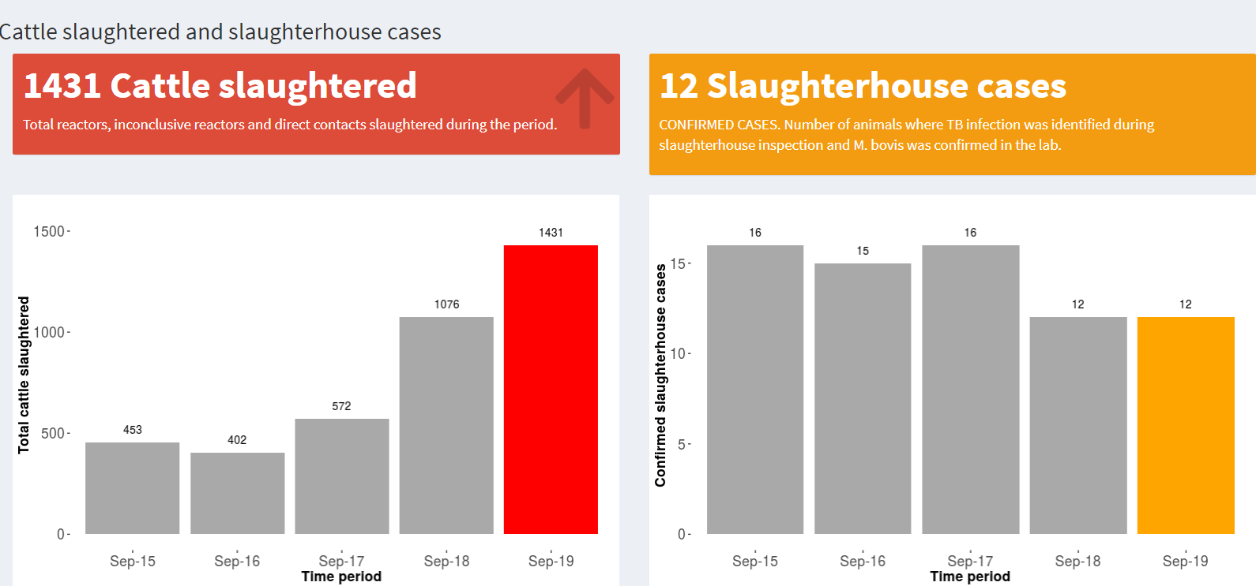

Slide 4
TB breakdowns 2019- not published yet
1291 reactor cattle slaughtered
612 were gamma (blood test reactors)
114 farms under restrictions as new breakdowns in 2019 (142 in 2018- due to 6 monthly testing)
12 in true EA 102 in old HRA part
90% of breakdowns are in the old HRA of Derbyshire
1733 herds in Derbyshire https://btb-statistics.shinyapps.io/dashboard_v1/

Slide 5
BADGER
77.35%
https://assets.publishing.service.gov.uk/government/uploads/system/uploads/attachment_data/file/830849/apha-epid-report-edge-area-derbyshire1.pd

Slide 6
Split Edge/HRA county until 2018
6 monthly TB testing
Compulsory gamma testing (expect to take 5-8%)
Nearly half the reactors in 2019 were gamma reactors
NOT yet happening in the HRA
We are tackling the cattle disease
original Edge
former HRA

Slide 7
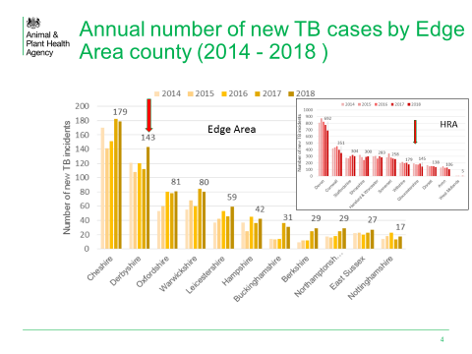
The red arrow shows where Derbyshire incidence compares to counties in the HRA. It sits at the same level as Gloucestershire

Slide 8
Density of cattle in Derbyshire (2018)
170,000 cattle in 1700 herds

Slide 9
Number of breakdowns (2009 – 2018)

Slide 10
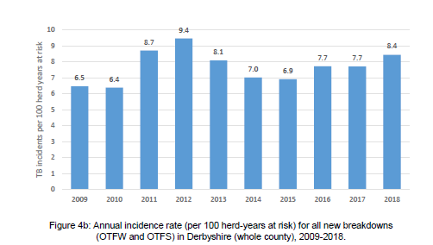

Slide 11
Herd incidence of TB represented as a spatial kernel of the 100 closest herds. Darker red is higher incidence.
Six-monthly herd testing area
Decreased incidence, 2017 to 2018
Stable incidence, 2017 to 2018
Increased incidence, 2017 to 2018
Prepared by the APHA
National TB Epidemiology team
August 2019
Notes:
From Ricardo de la Rua-Domenech 03/07/19:
Potential hotspot area HS22 was initially approved in Cumbria, east of Penrith and just north of HS21 (East Cumbria – Shap) in January 2018. There had been two or three OTFW incidents detected in the area over several years, all caused by genotypes of M. bovis different from 17:z. However, as more information emerged it was decided not to action the HS protocol and continue with the normal radial testing of the local cattle herds. By that time, the code HS23 had already been allocated to another potential bTB hotspot area in Lincs., so rather than rearrange the HS numbering sequence it was decided to retain HS22 on the list as an ‘inactive’ hotspot area.

Slide 12
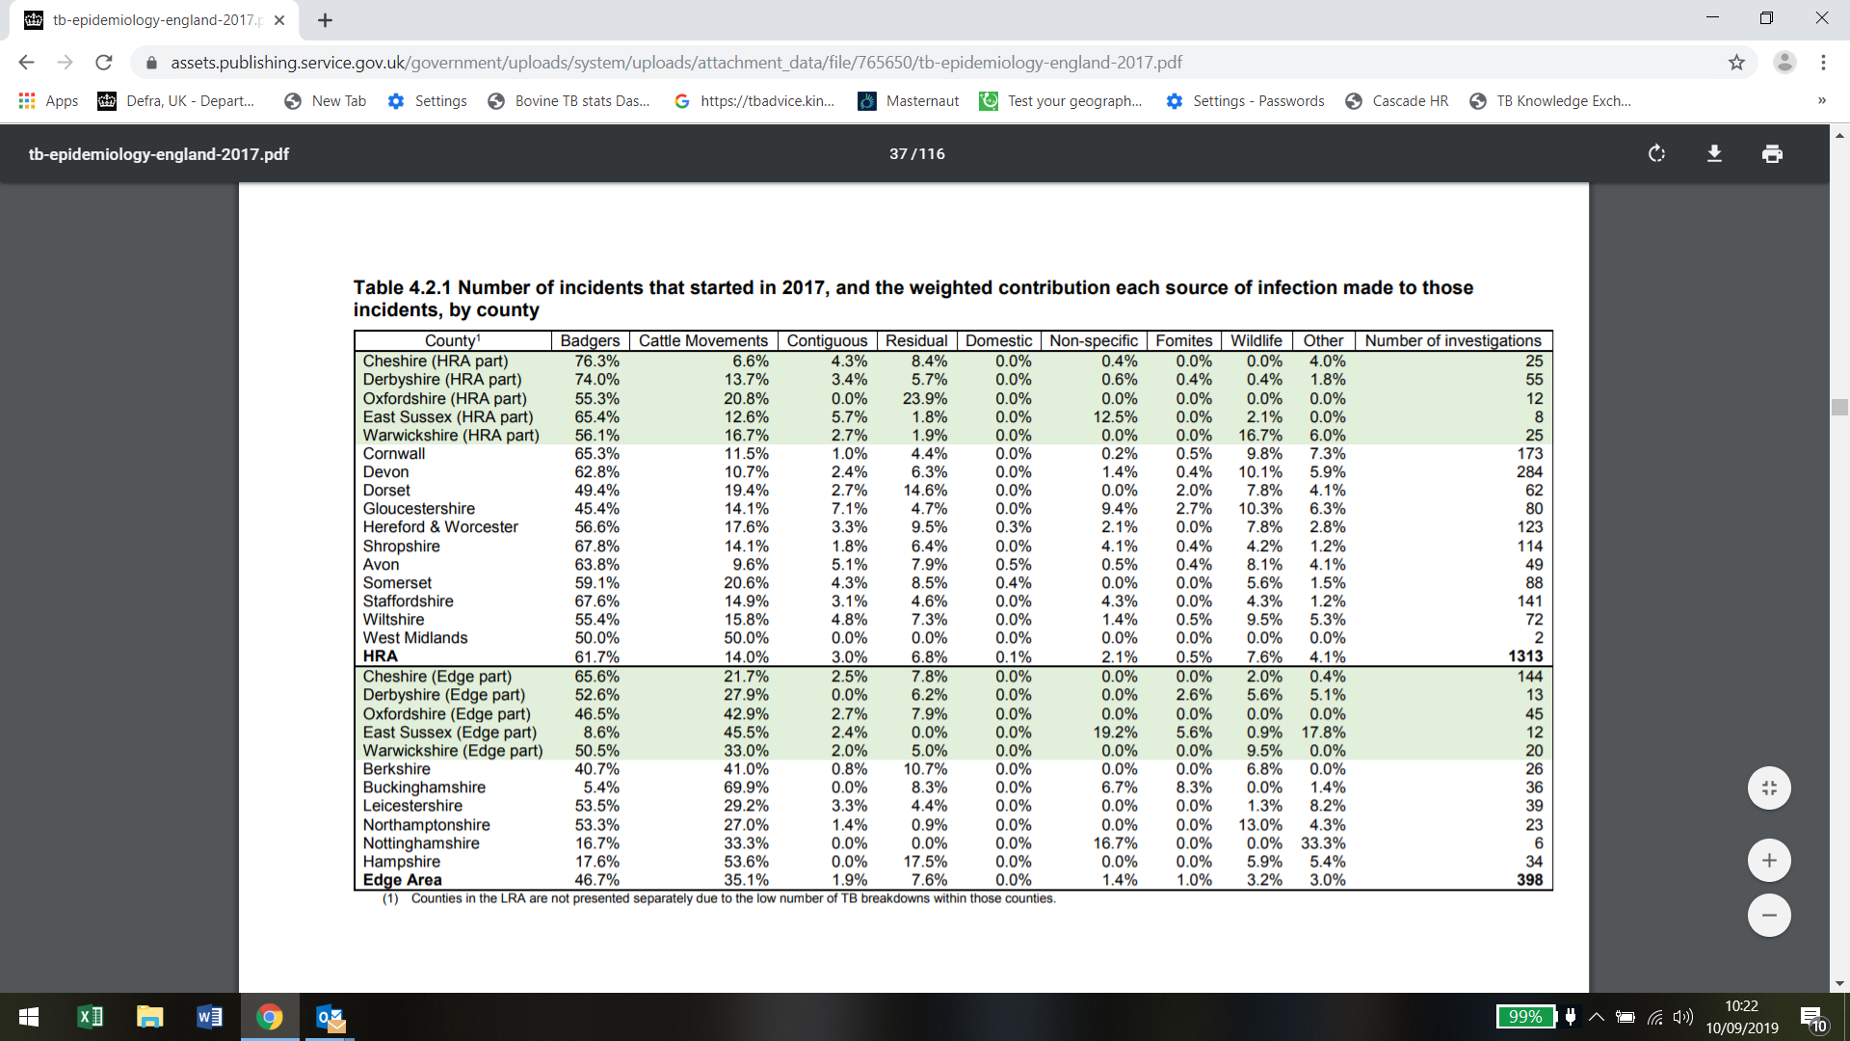

Slide 13
Cattle breakdowns with wildlife source (2018)

Slide 14
RED= Cattle bTB breakdowns YELLOW= Negative badgers PURPLE= Positive badgers
4/100 badgers positive
Large areas no badgers – high prevalence of bTB- OLD HRA
Large number from the old edge area = BEVS area
3 positive in Cumbria= 21% now in cull area
Malcom Bennett Notts Uni

Slide 15
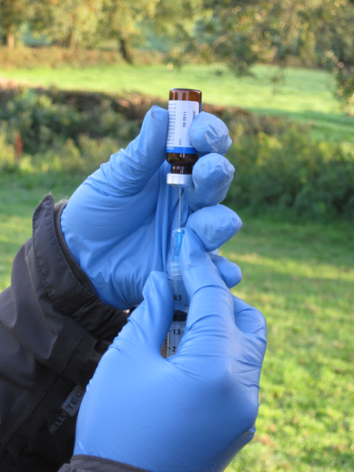
Badger Vaccination
Natural England has informed the Cull company there are no areas of “effective” badger vaccination in the cull area
The “flagship” vaccination area in Derbyshire is over 10km from the cull boundary
The “flagship” BEVS has only vaccinated 155 badgers out of an estimated population of 5500 between 2 and 3%
Is the vaccine effective in badgers? - YES
Reduces severity, progression and excretion
Vaccinated badgers 76% less likely to become infected
Vaccinating adults reduces infection in badger cubs
BUT….will not cure animals already infected
No evidence it reduce TB in cattle- costs £150 million per year to the treasury

